Slide 1
SEMANTIC ANALYSIS
- Dr. Kiran Bhowmick

Slide 2
Syllabus Content
Lexical Semantics, Attachment for Fragment of English- Sentences, Noun Phrases, Verb Phrases, Prepositional Phrases, Relations Among Lexemes & Their Senses –Homonymy, Polysemy, Synonymy, Hyponymy, WordNet, Robust Word Sense Disambiguation (WSD), Lexical Disambiguation, Resolving Lexical Ambiguity, Lexical Ambiguity Resolution

Slide 3
What is a Word?
Types, Tokens, roots, stems, inflected forms etc ….
Lexeme: A lexeme is a pairing of a particular orthographic and phonological form with some form of symbolic meaning representation.
Eg run, runs, ran, running are all forms of lexemes of run
Lexicon: is a finite list made up of lexemes.
Dictionaries are, after all, nothing if not repositories of information about the meanings of lexemes. Within dictionaries, it turns out that the most interesting place to look first is at the definitions of lexemes that no one ever actually looks up

Slide 4
What is a Word?
A lemma or citation form – Basic part of the word, same stem, rough semantics
A wordform – The “inflected” word as it appears in text
A "lexeme" refers to the entire set of related word forms sharing the same core meaning (like "run", "runs", "ran", "running") while a "lemma" is the single chosen form that represents that lexeme, usually the dictionary entry form (in this case, "run")
Essentially, a lexeme is the concept, and the lemma is the chosen representative form of that concept within a set of related words.
Lemma | Wordform
bank | banks
sing | sung
dormir | duermes

Slide 5
Lemmas and senses
lemma
mouse (N) 1. any of numerous small rodents... 2. a hand-operated device that controls a cursor...
3. a quiet, timid, or cowardly person
4. computing a hand-held device used to control the cursor movement and select computing functions without keying
sense
Modified from the online thesaurus WordNet
A sense or “concept” is the meaning component of a word
Lemmas can be polysemous (have multiple senses)

Slide 6
Relationship between word meaning
Homonym
Polysemy
Synonymy
Antonymy
Hypernomy
Hyponomy
Metonomy
Meronymy

Slide 7
Homonym
a relation that holds between words that have the same form with unrelated meanings.
Lexemes that share a form – phonological, orthographic or both.
But unrelated distinct meaning
Homonyms are generally defined as words different in meaning but either identical both in sound and spelling or identical only in sound or spelling.
E.g. bank
distinct financial institution and
sloping mound meanings
Example: i. Our house is on the West bank of the river
ii. I want to save my money in the bank.
bat₁: club for hitting a ball, bat₂: nocturnal flying mammal
1. Homographs are senses that are linked to lemmas with the same pronunciation and same spellings.
1. bank/bank
2. bat/bat
2. Homophones: are senses that are linked to lemmas with the same pronunciation but different spellings.
1. Write and right
2. Piece and peace

Slide 8
Homonyms in NLP
Information retrieval – “bat care”
Machine Translation – bat: murciélago (animal) or bate (for baseball)
Text-to-Speech – bass (stringed instrument) vs. bass (fish)

Slide 9
Synonymy
Synonyms have the same meaning in some or all contexts.
filbert / hazelnut
couch / sofa
big / large
automobile / car
vomit / throw up
water / H₂0
Two words are synonyms
if they can be substituted for each other in all situations
If so they have the same propositional meaning

Slide 10
Relation: Synonymy?
Very few (or none) examples of perfect synonymy
Even if many aspects of meaning are identical
Still may not preserve the acceptability based on notions of politeness, slang, genre etc.
Example
water / H₂0
big / large
Water / H2O
– H2O is used in scientific context.
– H2O of the sea is very cold or swimming in cold sea H2O needs practice and stamina (HuH !!!!!)
Big/large
– How big is that plane?
– Would I be flying on a large or small plane?
How about here:
– Miss Nelson became a kind of big sister to Benjamin.
– Miss Nelson became a kind of large sister to Benjamin.
Why?
– big has a sense that means being older, or grown up
– large lacks this sense
Synonymous relations must be defined between senses
Notes:
For example, the word H2O is used in scientific contexts and would be inappropriate in a surfing guide—water would be more appropriate— and this genre difference is part of the meaning of the word. In practice, the word synonym is therefore used to describe a relationship of approximate or rough synonymy.

Slide 11
Antonymy
Senses that are opposites with respect to one feature of meaning
Otherwise, they are very similar!
dark – light, short – long, fast – slow, rise – fall, hot – cold, up – down, in – out
Antonyms can
– Define a binary opposition: in/out
– Be at the opposite ends of a scale: fast/slow
– Be reversives: rise/fall
•Very tricky to handle with some representations

Slide 12
Polysemy
One lemma “bank” can have many meanings:
a bank can hold the investments in a custodial account
as agriculture burgeons on the east bank the river will shrink even more”
Sense (or word sense)
A discrete representation of an aspect of a word’s meaning.
The lemma bank here has two senses
Another Example
The bank was constructed in 1875 out of local red brick
I withdrew money from the bank
Sense1: The building belonging to a financial institution
Sense 2: A financial institution

Slide 13
Polysemy
Systematic Polysemy: A systematic relationship between senses
School, University, hospital – All can mean building or institution
Systematic relationship
Building ↔ Organization
Other kinds of Systematic relationship
Author (Jane Austen wrote Emma)
↔ Works of Author (I love Jane Austen)
Tree (Plums have beautiful blossoms)
↔ Fruit (I ate a preserved plum)

Slide 14
How do we know when a word has more than one sense?
– Which flights serve breakfast?
– Does Lufthansa serve Philadelphia?
The “Zeugma Test”
Which flights serve breakfast and Philadelphia?
Does Lufthansa serve Philadelphia and breakfast?
Since these conjunctions sound weird
We say the word “serve” has two different senses

Slide 15
Hyponymy and Hypernymy
One sense is a hyponym of another if the first sense is more specific, denoting a subclass of the other
– car is a hyponym of vehicle
– mango is a hyponym of fruit
Conversely hypernym/superordinate (“hyper is super”)
– vehicle is a hypernym of car
– fruit is a hypernym of mango

Slide 16
Hyponymy more formally
Extensional – class denoted by superordinate extensionally includes the class denoted by the hyponym
Entailment –
A sense A is a hyponym of sense B if being A entails being B
Example – If it is a Mango then it is a Fruit
Usually transitive
– (A hypo B and B hypo C entails A hypo C)
Another relation – IS-A relation
– Mango IS-A Fruit
– Car IS-A Vehicle

Slide 17
Hyponymy and instances
WordNet like a dictionary but much more than a dictionary
WordNet has both Classes and instances
Instance – a proper noun that is unique entity
Mumbai is an instance of a city
But city is a class
City is an hyponym of municipality
Example:
Mango is an hyponym of Fruit
Alphanso is an instance of Mango

Slide 18
Metonymy
is a figure of speech where one thing is substituted for another based on a related concept or association
the substitution of the name of an attribute or adjunct for that of the thing meant,
for example suit for business executive, or the turf for horse racing.
Example:
"Plate" can mean an entire plate of food
"Lend me your ears" is a popular metonymy phrase. It means to give someone their attention.
"Jeff is a real silver fox!“ This is a metonymy that means that Jeff is an attractive older man.
"Give me a hand" means to give someone help.
"Cuba has passed a bill." Using the name of a country can be used as a metonymy to use in place of that country's government or economy.

Slide 19
Meronymy
Definition: Meronymy describes the semantic relationship between a part and a whole.
Meronym: A word that names a part of something
Holonym: A word that names the whole of which the meronym is a part.
Example:
"Wheel" is a meronym of "car", and "car" is the holonym.
"Leaf" is a meronym of "tree", and "tree" is the holonym.
"Brim" and "crown" are meronyms of "hat".
"Cover" and "page" are meronyms of "book".
"Tire" is a meronym of "car".
"Eye" is a meronym of "face".
"Cushion" is a meronym of "chair".

Slide 20
WordNet
WordNet is the lexical database i.e. dictionary for the English language, specifically designed for natural language processing.
A hierarchically organized lexical database
Properties:
Synonyms are grouped together in something called Synset
A synset contains lemmas, which are the base form of a word
Statistics of WordNet 3.0
WordNet provides database only for the above listed categories – “content words”
Category | Unique Strings
Noun | 117,798
Verb | 11,529
Adjective | 22,479
Adverb | 4,481

Slide 21
WordNet
Bass
Noun
S: (n) bass (the lowest part of the musical range)
S: (n) bass, bass part (the lowest part in polyphonic music)
S: (n) bass, basso (an adult male singer with the lowest voice)
S: (n) sea bass, bass (the lean flesh of a saltwater fish of the family Serranidae)
S: (n) freshwater bass, bass (any of various North American freshwater fish with lean flesh (especially of the genus Micropterus))
S: (n) bass, bass voice, basso (the lowest adult male singing voice)
S: (n) bass (the member with the lowest range of a family of musical instruments)
S: (n) bass (nontechnical name for any of numerous edible marine and freshwater spiny-finned fishes)
Adjective
S: (adj) bass, deep (having or denoting a low vocal or instrumental range) "a deep voice"; "a bass voice is lower than a baritone voice"; "a bass clarinet"

Slide 22
WordNet
Cricket
Noun
S: (n) cricket (leaping insect; male makes chirping noises by rubbing the forewings together)
S: (n) cricket (a game played with a ball and bat by two teams of 11 players; teams take turns trying to score runs)
Verb
S: (v) cricket (play cricket)
How is sense defined in WordNet ???
Each word in WordNet has at least one sense
• The synset (synonym set), the set of near-synonyms, is a set of senses with a gloss
Key: "S:" = Show Synset (semantic) relations, "W:" = Show Word (lexical) relations
Display options for sense: (gloss) "an example sentence"

Slide 23
Senses and Synsets in WordNet
• Example: chump as a noun with the gloss:
“a person who is gullible and easy to take advantage of”
• This sense of “chump” is shared by 9 words:
chump¹, fool², gull¹, mark⁹, patsy¹, fall guy¹, sucker¹, soft touch¹, mug²
• All these senses have the same gloss
Noun
S: (n) chap, fellow, feller, fella, lad, gent, blighter, cuss, bloke (a boy or man) "that chap is your host"; "there's a fellow at the door"; "he's a likable cuss"; "he's a good bloke"
S: (n) cub, lad, laddie, sonny, sonny boy (a male child (a familiar term of address to a boy))

Slide 24
Word Sense Disambiguation
Word sense disambiguation, in natural language processing (NLP), may be defined as the ability to determine which meaning of word is activated by the use of word in a particular context
For example, consider the two examples of the distinct sense that exist for the word “bass” −
I can hear bass sound.
He likes to eat grilled bass.
The occurrence of the word bass clearly denotes the distinct meaning.
In first sentence - it means frequency
in second - it means fish.
Hence, if it would be disambiguated by WSD then the correct meaning to the above sentences can be assigned as follows −
I can hear bass/frequency sound.
He likes to eat grilled bass/fish.
The task of word sense disambiguation is to examine word tokens in context and specify which sense of each word is being used.

Slide 25
Word Sense Disambiguation
Some means of selecting correct sense is required
- The enormous amount of homonymy and polysemy in the lexicon will quickly overwhelm any approach
- Many competing interpretations will result.
Two fundamental approaches to handling this ambiguity problem:
First - The selection of correct senses during semantic analysis as a side-effect of the elimination of ill-formed representations composed from an incorrect combination of senses.
Using restrictions and type hierarchies as the primary knowledge sources
rule out inappropriate senses and thereby reduce the amount of ambiguity present during semantic analysis
selection restrictions can be used to block the formation of component meaning representations that contain violations
By blocking such ill-formed components, the semantic analyser will find itself dealing with fewer ambiguous meaning representations.
This ability to focus on correct senses by eliminating flawed representations that result from incorrect senses can be viewed as a form of indirect word sense disambiguation.
Second - Sense disambiguation performed as a stand-alone task independent of, and prior to, compositional semantic analysis.
This approach is direct word sense disambiguation

Slide 26
WSD
INDIRECT APPROACH: SELECTIONAL RESTRICTION based DISAMBIGUATION

Slide 27
Indirect approach - Selection Restriction based Disambiguation
Example 1: Predicate
“In our house, everybody has a career and none of them includes washing dishes”, he says.
“In her tiny kitchen at home, Ms. Chen works efficiently, stir-frying several simple dishes, including braised pig’s ears and chicken livers with green peppers”
Two polysemous senses of the lexeme dish : 1. physical objects that we eat from and 2. actual meal or recipe
We do not perceive any ambiguity in these two sentences - Why???
Selection restrictions imposed by wash and stir-fry – ambiguity is resolved
wash does not apply to meal and stir-fry does not apply to dishes
Therefore, in both of these cases, the predicate selects the correct sense of an ambiguous argument by eliminating the sense that fails to match one of its selection restrictions.

Slide 28
Selection Restriction based Disambiguation
Example 2: Case of ambiguous predicate
“Well, there was the time they served green-lipped mussels from New Zealand.”
“Which airlines serve Denver?”
“Which ones serve breakfast?”
Polysemous senses of the lexeme serve : 1. food 2. geographical or political entity 3. meal designator
Mussels, Denver and breakfast are unambiguous,
So the arguments in these examples select the appropriate sense of the verb

Slide 29
Selection Restriction based Disambiguation
Example 3: cases where both the predicate and the argument have multiple senses
“I’m looking for a restaurant that serves vegetarian dishes.”
Six possible combinations:
Two polysemous senses of the lexeme dish : 1. physical objects that we eat from and
2. actual meal or recipe
Three polysemous senses of the lexeme serve : 1. food
2. geographical or political entity
3. meal designator
Since only one combination of the six is free from a selection restriction violation, determining the correct sense of both serve and dish is straightforward.
In particular, the predicate and argument mutually select the correct senses.
Argument for serves – vegetarian – food or person
Predicate of dishes – vegetarian – meal

Slide 30
Selection Restriction based Disambiguation
Example 4:
“What kind of dishes do you recommend?”
In cases like this we either have to rely on the stand-alone methods of WSD or knowledge of the broader discourse context.
the most straightforward approach for disambiguation is to follow the rule-to-rule strategy:
Fragments of meaning representations are composed for the constituents
These are then Checked for selection restriction violations
Eliminate senses that violate the selection restrictions
What is needed to integrate this strategy in semantic analyzer??
access to hierarchical type information about the arguments – hypernym
semantic selection restriction information about the arguments to predicates – Synset
Where is this kind of information available??
WordNet

Slide 31
Drawback of Selection Restriction based Disambiguation
1. There are many perfectly well-formed, interpretable, sentences that contain obvious violations of selection restrictions. Therefore, any approach based on a strict elimination of such interpretations is in serious trouble.
“But it fell apart in 1931, perhaps because people realized you can’t eat gold for lunch if you’re hungry”
Here, eat gold violates the selection restriction that eat places.
Eat – food / meal
However, the sentence is well formed.
The key is the negative environment set up by can’t prior to the violation of the restriction.
any purely local, or rule-to rule, analysis of selection restrictions will fail when a wider context makes the violation of a selection restriction acceptable

Slide 32
Drawback of Selection Restriction based Disambiguation
2. The thematic roles and selection restrictions are merely loose approximations of the deeper concepts they represent.
“In his two championship trials, Mr. Kulkarni ate glass on an empty stomach, accompanied only by water and tea”
the above sentence is Perfectly well-framed – not semantically ill-formed.
However, eat glass requires deeper commonsense knowledge about what eating is all about.
At best, they reflect the idea that the things that are eaten are normally edible

Slide 33
Drawback of Selection Restriction based Disambiguation
3. The metaphoric and metonymic uses.
“If you want to kill the Soviet Union, get it to try to eat Afghanistan”
Here the typical selection restrictions on both kill and eat will eliminate all possible literal senses leaving the system with no possible meanings.
In many systems, such a situation serves to trigger alternative mechanisms for interpreting metaphor and metonymy.
examples like these often result in the elimination of all senses, bring semantic analysis to a halt
One approach to alleviating this problem is to adopt the view of selection restrictions as preferences rather than rigid requirements – Selectional Association based disambiguation
The Resnik’s disambiguation algorithm is to select as the correct sense for the argument, by choosing the one that has the highest selectional association between one of its ancestor hypernyms and the predicate

Slide 34
WSD
INDIRECT APPROACH: SELECTIONAL ASSOCIATION based DISAMBIGUATION

Slide 35
Selectional Association based disambiguation
The selectional association uses an empirically derived measure of the strength of association between a predicate and a class dominating the argument to the predicate.
Resnik’s disambiguation: The algorithm selects the correct sense for the argument by choosing the one that has the highest selectional association between one of its ancestor hypernyms and the predicate.

Slide 36
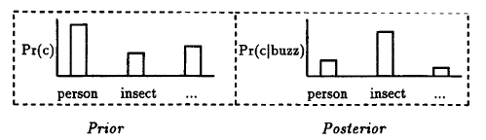
Selectional Association based disambiguation
Selectional preference strength: amount of information that a predicate tells us about the semantic class of its arguments.
E.g: 1. eat tells us a lot about the semantic class of its direct objects
2. be doesn’t tell us much
The selectional preference strength :
the difference between conditional or posterior distribution and the prior distribution that determines selectional preference:
P(c) the distribution of expected semantic classes for any direct object (prior probability)
P(c|v) the distribution of expected semantic classes for this verb v (conditional probability)
The greater the difference, the more the verb is constraining its object
How much information (in bits) the verb expresses about the semantic class of its argument
Resnik paper
Selectional association of a verb with a class: The relative contribution of the class to the general preference of the verb
Characterizing semantic fit

Slide 37
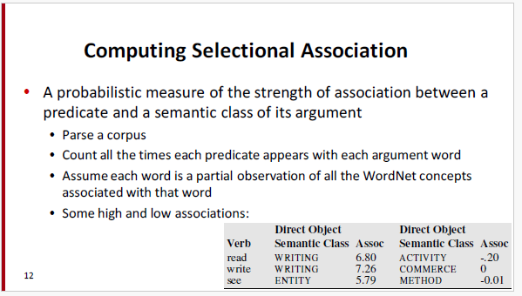
Selectional Association based disambiguation

Slide 38
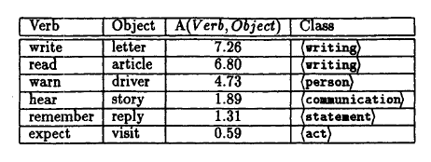
Selectional Association based disambiguation
For example, letter has 3 senses in WordNet and belongs to 19 classes in all.
In order to approximate its plausibility as the object of write, the selectional association with write was computed for all 19 classes, and the highest value returned - in this case, (writing)

Slide 39
Limitations of Selectional Association based disambiguation
It only addresses the case where the predicate is unambiguous and selects the correct sense of the argument.
Cannot detect metonymy
Example:
The spokesman denied the statement
The White House denied the statement
It has too many requirements – not useful in large-scale practical applications
the requirements of complete selection restriction information for all predicate roles, and complete type information for the senses of all possible fillers are unlikely to be met even with WordNet

Slide 40
WSD
DIRECT APPROACH: MACHINE LEARNING SUPERVISED

Slide 41
Word Sense Disambiguation
I. Machine Learning Approaches:
A classifier is trained to assign unseen samples to one of a fixed number of senses.
The approaches depend on
Nature of the training material,
how much material is needed,
the degree of human intervention,
the kind of linguistic knowledge used,
and the output produced
emphasis on acquiring the knowledge needed for the task from data, rather than from human analysts.
Scalable - apply the method to a substantial part of the entire vocabulary of a language?

Slide 42
Word Sense Disambiguation
The Inputs: Feature Vectors:
Initial Input
Target word - the word to be disambiguated,
its context - a portion of the text in which it is embedded,
Initial processing:
The input is normally part-of-speech tagged using one of the high accuracy methods
The original context may be replaced with larger or smaller segments surrounding the target word.
Often some amount of stemming, or more sophisticated morphological processing, is performed.
some form of partial parsing, or dependency parsing, is performed to ascertain thematic or grammatical roles and relations.

Slide 43
Word Sense Disambiguation
The Inputs: Feature Vectors:
FEATURE VECTOR
selecting the relevant linguistic features, and
Encoding them in a form usable in a learning algorithm.
a simple feature vector consisting of numeric or nominal values can easily encode the most FEATURE VECTOR frequently used linguistic features
Two kinds of features in the vectors
Collocational feature vector | Co-occurrence feature vector
quantifiable position-specific relationship between two lexical items Features about words at specific positions near target word Often limited to just word identity and POS | Features about words that occur anywhere in the window (regardless of position) Typically limited to frequency counts

Slide 44
Word Sense Disambiguation
Example Co-location
Text:
An electric guitar and bass player stand off to one side not really part of the scene
Assume a window of +/- 2 from the target
An electric guitar and bass player stand off to one side not really part of the scene
A feature-vector consisting of the two words to the right and left of the target word, along with their respective parts-of-speech, would yield the following vector.
[guitar, NN, and, CC, player, NN, stand, VB]

Slide 45
Word Sense Disambiguation
Example Co-occurrence
co-occurrence data about neighbouring words, ignoring their exact position
“an unordered set of words” – position ignored
Counts of words occurring within the window.
First choose a vocabulary
Then count how often each of those terms occurs in a given window
sometimes just a binary “indicator” 1 or 0
Example
An electric guitar and bass player stand off to one side not really part of the scene
Assume we’ve settled on a possible vocabulary of 12 words in “bass” sentences drawn from WSJ corpus would have features as: [fishing, big, sound, player, fly, rod, pound, double, runs, playing, guitar, band]
Using these words as features with a window size of 10, Example above would be represented by the following vector.
The vector for: guitar and bass player stand
[0,0,0,1,0,0,0,0,0,0,1,0]

Slide 46
Word Sense Disambiguation
1. A Dictionary : which is used to specify the senses to be disambiguated.
2. Test Corpus : high-annotated test corpus that has the target or correct-senses.
The test corpora can be of two types
Lexical sample − This kind of corpora is used in the system, where it is required to disambiguate a small sample of words.
Small pre-selected set of target words (line, plant)
And inventory of senses for each word
Supervised machine learning: train a classifier for each word
Line hard serve corpus -­‐ 4000 examples of each
Interest corpus -­‐ 2369 sense-­‐tagged examples
All-words − This kind of corpora is used in the system, where it is expected to disambiguate all the words in a piece of running text.
Every word in an entire text
A lexicon with senses for each word
Data sparseness: can’t train word-specific classifiers
SemCor: 234,000 words from Brown Corpus, manually tagged with WordNet senses
SENSEVAL-­‐3 competition corpora -­‐ 2081 tagged word tokens

Slide 47
Word Sense Disambiguation
Supervised Learning Approaches:
Input
a word w in a text window d,
a fixed set of classes C = {c1,c2,…,cJ}
A set of m hand labeled text windows called documents (d1, c1), (d2, c2) … (dm, cm)
Output:
a learned classifier d -> c
The output of the system is a classifier system capable of assigning labels to new feature-encoded inputs
Evaluation:
precision: the percentage of words that are tagged correctly.
The output of the system is a classifier system capable of assigning labels to new feature-encoded inputs
Classifiers that can be used:
Naive Bayes
Logistic regression
Neural Networks
Support vector machines
k-­Nearest Neighbors

Slide 48
Word Sense Disambiguation
Naïve Bayes Approaches:
P(c) is the prior probability of that sense
Counting in a labeled training set.
P(c) = Nc / N
P(w|c) conditional probability of a word given a particular sense
P(w|c) = count(w,c)/count(c)
We get both of these from a tagged corpus like SemCor
Example:
V = {fish, smoked, line, haul, smoked, guitar, jazz}
 | Doc | Words | Class
Training | 1 | Fish smoked fish | f
 | 2 | Fish line | f
 | 3 | Fish haul smoked | f
 | 4 | Guitar jazz line | g
Testing | 5 | Line guitar jazz jazz | ??

Slide 49
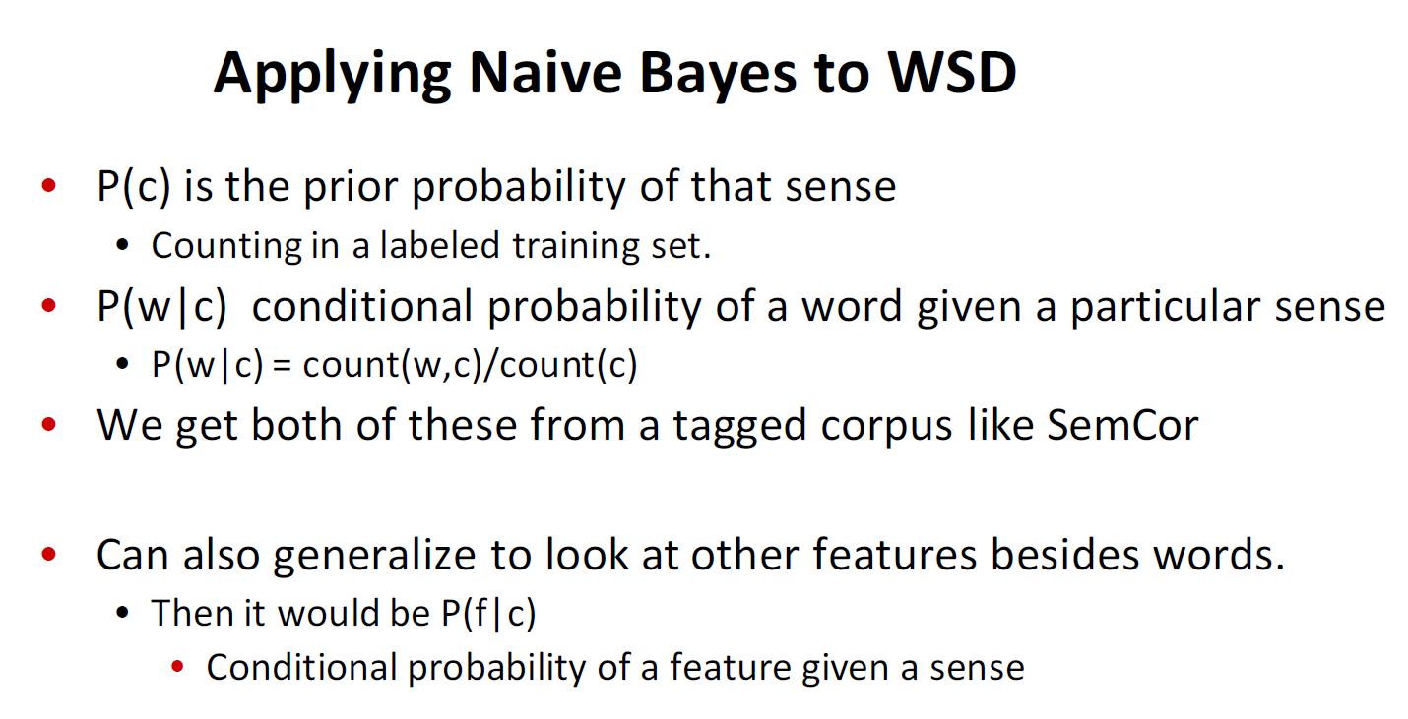
Word Sense Disambiguation

Slide 50
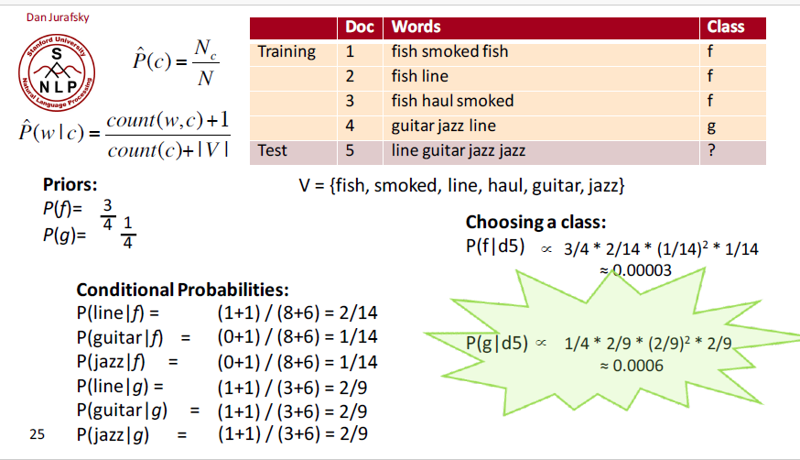
Word Sense Disambiguation

Slide 51
WSD
DIRECT APPROACH: DICTIONARY BASED (LESK ALGORITHM)

Slide 52
Word Sense Disambiguation – Dictionary based approach
II. Dictionary based approaches
In this approach, all the sense definitions of the word to be disambiguated are retrieved from the dictionary.
These senses are then compared to the dictionary definitions of all the remaining words in the context.
The sense with the highest overlap with these context words is chosen as the correct sense.
How it works
Requires a Machine Readable Dictionary (MRD)
Maintains two bags: Sense bags and Context bags
Sense bags – consists of all the different senses of the word (all meanings of the sense available in the dictionary)
Context bags – features of the word in its context (all the words from the
Sense bag – include all the meanings of the sense available in the dictionary. Each meaning is maintained as one sense bag
E.g. Bank1 sense: Financial institution
Bank2 sense: sloping land ….
Context bag – all the words other than the ambiguated word in the sentence.
Compare each sense bag with the context bag and find the number of overlapping words
The sense bag with maximum overlapping words is the correct sense of the ambiguated word.

Slide 53
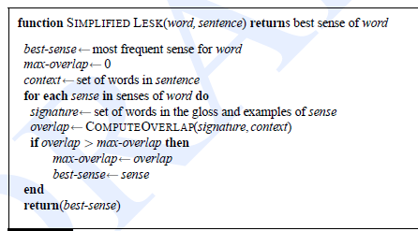
Word Sense Disambiguation – Dictionary based approach
Lesk Algorithm:
The Lesk algorithm is the seminal dictionary-based method.
It is based on the hypothesis that words used together in text are related to each other and that the relation can be observed in the definitions of the words and their senses.
Two (or more) words are disambiguated by finding the pair of dictionary senses with the greatest word overlap in their dictionary definitions.
It searches for the shortest path between two words: the second word is iteratively searched among the definitions of every semantic variant of the first word, then among the definitions of every semantic variant of each word in the previous definitions and so on.
Finally, the first word is disambiguated by selecting the semantic variant which minimizes the distance from the first to the second word."

Slide 54
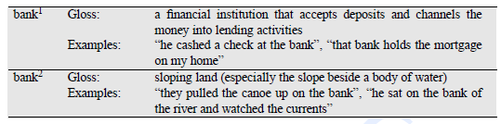
Word Sense Disambiguation – Dictionary based approach
Lesk Algorithm Example:
To disambiguate the word “bank” in the following example:
The bank can guarantee deposits will eventually cover future tuition costs because it invests in adjustable-rate mortgage securities.
Sense bank1 has two (non-stop) words overlapping viz., deposits and mortgage,
while sense bank2 has zero, so sense bank1 is chosen

Slide 55

Word Sense Disambiguation – Dictionary based approach
Problems with Lesk is that the dictionary entries for the target words are short, and may not provide enough chance of overlap with the context.
One remedy is to expand the list of words used in the classifier to include words related to, but not contained in their individual sense definitions.
But the best solution, if any sense-tagged corpus data like SemCor is available, is to add all the words in the labeled corpus sentences for a word sense into the signature for that sense.
This version of the algorithm, the Corpus Lesk algorithm is the best-performing of all the Lesk variants and is used as a baseline in the SENSEVAL competitions.
Instead of just counting up the overlapping words, the Corpus Lesk algorithm also applies a weight to each overlapping word.
The weight is the inverse document frequency or IDF, a standard information-retrieval measure
IDF measures how many different ’documents’ (in this case glosses and examples) a word occurs in and is thus a way of discounting function words.
Since function words like the, of, etc, occur in many documents, their IDF is very low, while the IDF of content words is high.
Corpus Lesk thus uses IDF instead of a stoplist.
Formally the IDF for a word i can be defined as
where Ndoc is the total number of ‘documents’ (glosses and examples) and ndi is the number of these documents containing word i.

Slide 56
WSD
DIRECT APPROACH: MACHINE LEARNING BOOTSTRAPPING APPROACHES (SEMI-SUPERVISED)

Slide 57
Word Sense Disambiguation – Semi-supervised approach
III. Bootstrapping Approaches:
a major problem with supervised approaches is the need for a large sense-tagged training set.
The bootstrapping approach eliminates the need for a large training set by relying on a relatively small number of instances of each sense for each lexeme of interest.
These labeled instances are used as seeds to train an initial classifier using any of the supervised learning methods mentioned in the last section.
This initial classifier is then be used to extract a larger training set from the remaining untagged corpus.
Repeating this process results in a series of classifiers with improving accuracy and coverage.
In each iteration it includes only those instances in which the initial classifier has a high degree of confidence. This larger training set is then used to create a new more accurate classifier with broader coverage.
With each iteration of this process, the training corpus grows and the untagged corpus shrinks.
This process can be repeated until some sufficiently low error-rate on the training set is reached, or until no further examples from the untagged corpus are above threshold.
The initial seed set used in these bootstrapping methods can be generated in a number of ways. Hearst (1991) generates a seed set by hand labeling a small set of examples from the initial corpus.
This approach has three major advantages:
There is a reasonable certainty that the seed instances are correct, thus ensuring that the learner does not get off on the wrong foot.
The analyst can make some effort to choose examples that are not only correct, but in some sense prototypical of each sense.
It is relatively easy to carry out.

Slide 58
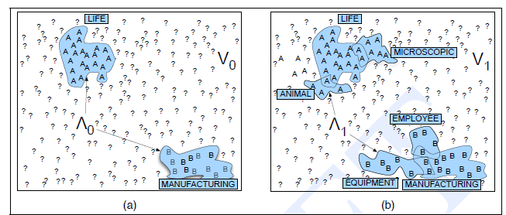
Word Sense Disambiguation – Semi-supervised approach

Slide 59
WSD
DIRECT APPROACH: THESAURUS BASED (WALKER’S ALGORITHM)

Slide 60
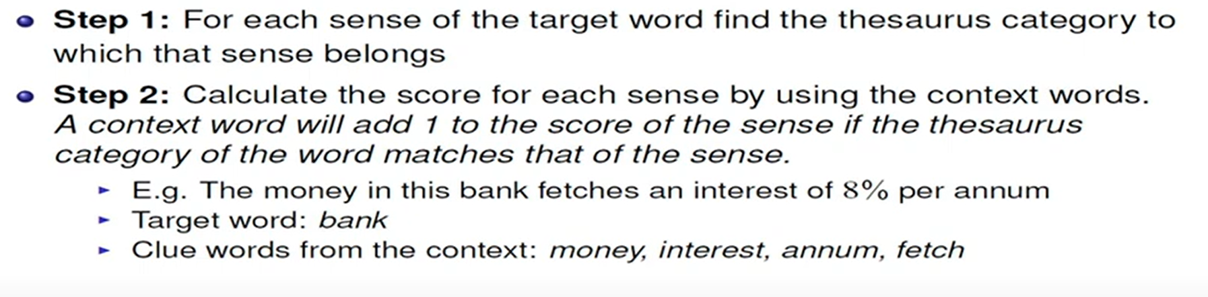
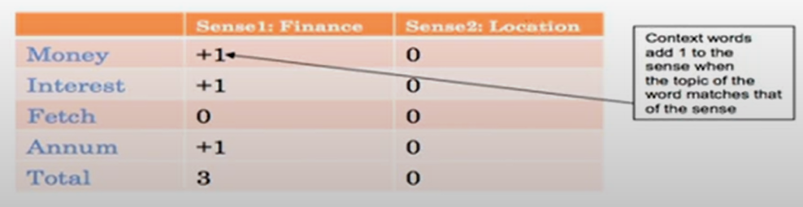
Word Sense Disambiguation – Thesaurus based approach
II. Thesaurus based approach – Walkers Algorithm
Thesaurus consists of categories of senses
E.g finance, location
Problem is which category a sense belongs to and identify the appropriate category
How it works:
Here, score of finance is more so the sense category is finance.

Slide 61
Word Sense Similarity
Using Thesaurus and Distribution Methods

Slide 62
Word Sense Similarity
I. Introduction
Word similarity plays a crucial role in natural language processing tasks such as information retrieval, text classification, and machine translation. It allows us to measure the similarity between words and understand their semantic relationships. In this topic, we will explore two approaches to word similarity: thesaurus-based methods and distributional methods. Additionally, we will discuss the concept of compositional semantics and its role in enhancing word similarity.
II. Thesaurus-based Word Similarity
A thesaurus is a lexical resource that organizes words based on their semantic relationships. Thesaurus-based word similarity relies on the hierarchical structure of a thesaurus to measure the similarity between words. Here is a step-by-step walkthrough of thesaurus-based word similarity:
Building a thesaurus: The first step is to construct a thesaurus by manually or automatically extracting semantic relationships between words.
Calculating word similarity using thesaurus: Once the thesaurus is built, we can measure the similarity between two words by calculating the shortest path between them in the thesaurus hierarchy.
Thesaurus-based word similarity has been applied in various real-world applications such as information retrieval, word sense disambiguation, and query expansion. However, it has some limitations. For example, it heavily relies on the quality and coverage of the thesaurus, and it may not capture the nuances of word meanings.

Slide 63
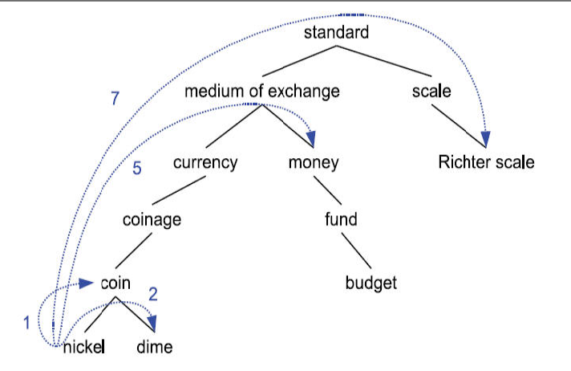


Word Sense Similarity – Thesaurus based
The shorter the path between two words or senses in the graph defined by the thesaurus hierarchy the more similar they are.
Example: the concept dime is most similar to nickel and coin, less similar to money, and even less similar to Richter scale.
Pathlen (c₁ and c₂) - the number of edges in the shortest path in the thesaurus graph between the sense nodes c1 and c2
path length based similarity:
word similarity based on sense similarity we can define as follows
the pair of senses for the two words that results in maximum sense similarity

Slide 64
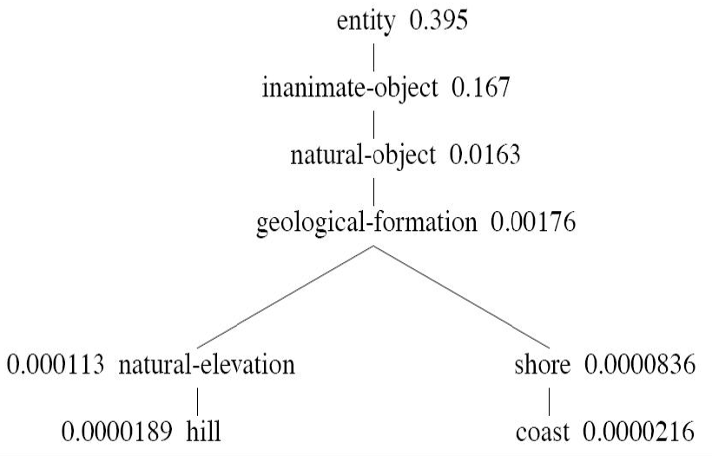

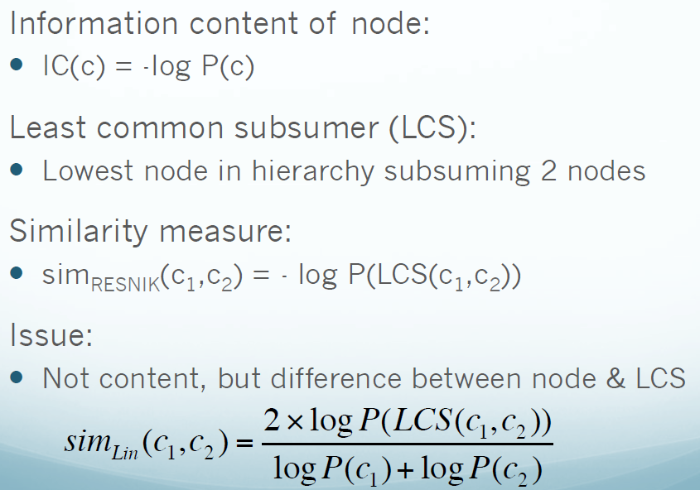
Word Sense Similarity – Thesaurus based second approach
content word similarity algorithms still rely on the structure of the thesaurus, but also add probabilistic information derived from a corpus
Where words(c) is the set of words subsumed by concept c, and N is the total number of words in the corpus that are also present in the thesaurus.
fragment of the WordNet concept hierarchy augmented with the probabilities P(c)
Lin’s Similarity:
the information in common between two concepts is twice the information in the lowest common subsumer LCS(c1,c2).

Slide 65
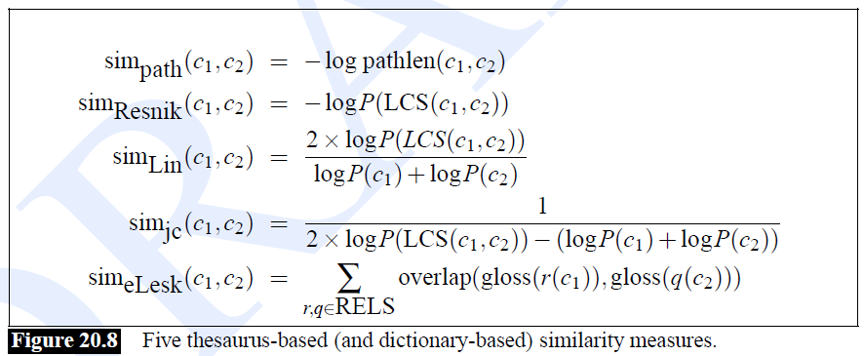
Word Sense Similarity – Thesaurus based second approach

Slide 66
Word Sense Similarity – distributional methods
III. Distributional Methods for Word Similarity
Distributional methods for word similarity are based on the distributional hypothesis, which states that words with similar meanings tend to occur in similar contexts. Here is a step-by-step walkthrough of distributional methods for word similarity:
Building word vectors: The first step is to represent words as high-dimensional vectors based on their co-occurrence patterns in a large corpus.
Calculating word similarity using distributional methods: Once the word vectors are constructed, we can measure the similarity between two words by calculating the cosine similarity between their vectors.
Distributional methods have been widely used in natural language processing tasks such as word sense disambiguation, sentiment analysis, and document clustering. However, they may struggle with capturing rare or context-dependent word meanings.

Slide 67
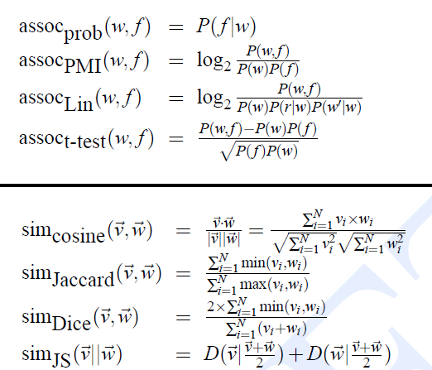
Word Sense Similarity – distributional methods

Slide 68
WSD
UNSUPERVISED APPROACHES – Discovering Word Senses

Slide 69

Word Sense Disambiguation – Unsupervised approach
Let’s see how we use these context vectors (whether first-order or second-order) in unsupervised sense disambiguation of a word w.
In training, we’ll need only 3 steps:
1. For each token wi of word w in a corpus, compute a context vector .
2. Use a clustering algorithm to cluster these word token context vectors into a
predefined number of groups or clusters. Each cluster defines a sense of w.
3. Compute the vector centroid of each cluster. Each vector centroid is a sense vector representing that sense of w.
Now how do we disambiguate a particular token t of w? Again we have three steps:
Compute a context vector for t as discussed above.
2. Retrieve all sense vectors for w.
3. Assign t to the sense represented by the sense vector that is closest to t
Feature vector ->

